Slide 1
Python Data Analytics Project “Churn Customers Data Analytics & Prediction” Technion - Israel Institute of Technology Continuing and Professional Education Course: Big Data Analyst Submitted by: Slava Bakman, Haim Zimbovsky, Gabriel Halimi

Slide 2
Data Description

Slide 3
Data Description
Examples: 7043
Train: 5634 (80%)
Test: 1489 (20%)
Features: 21

Slide 4
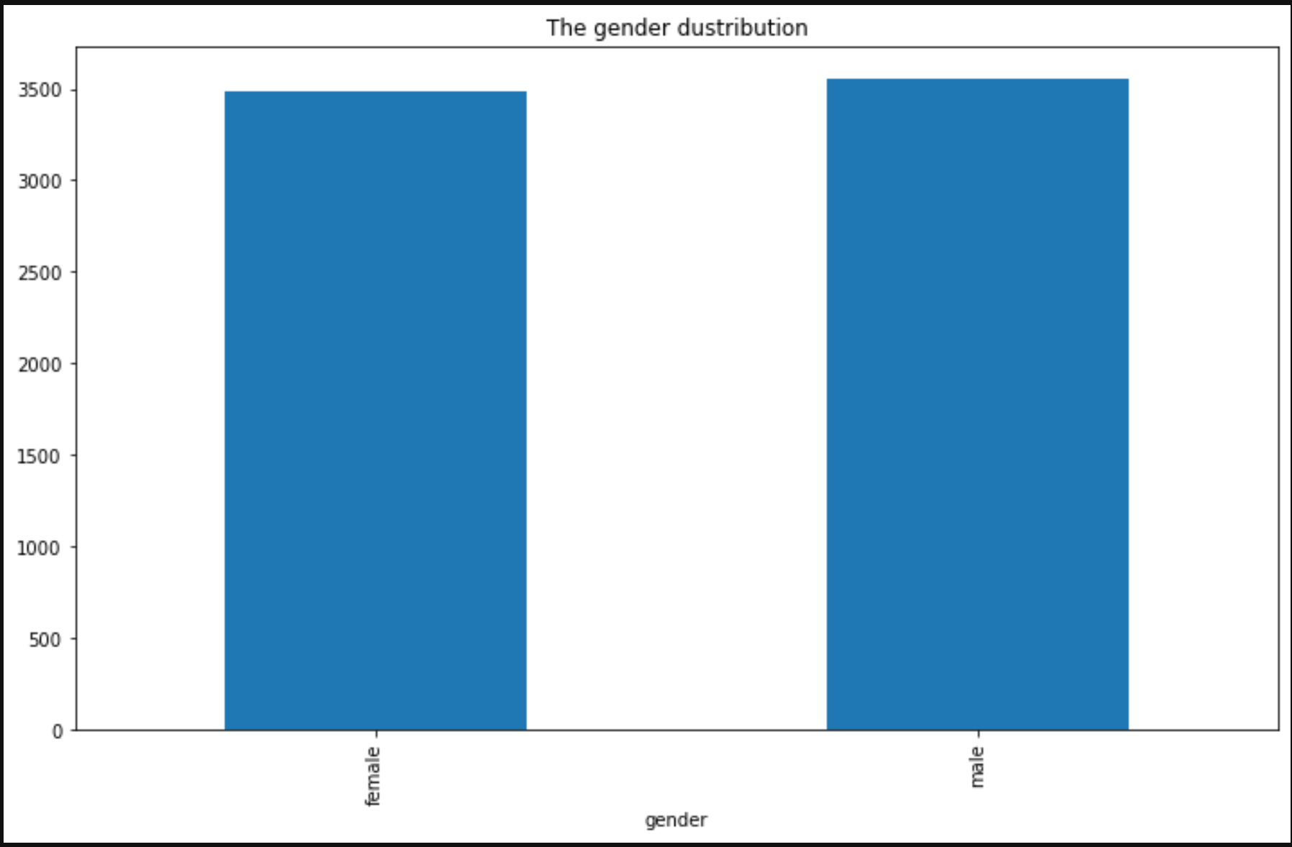
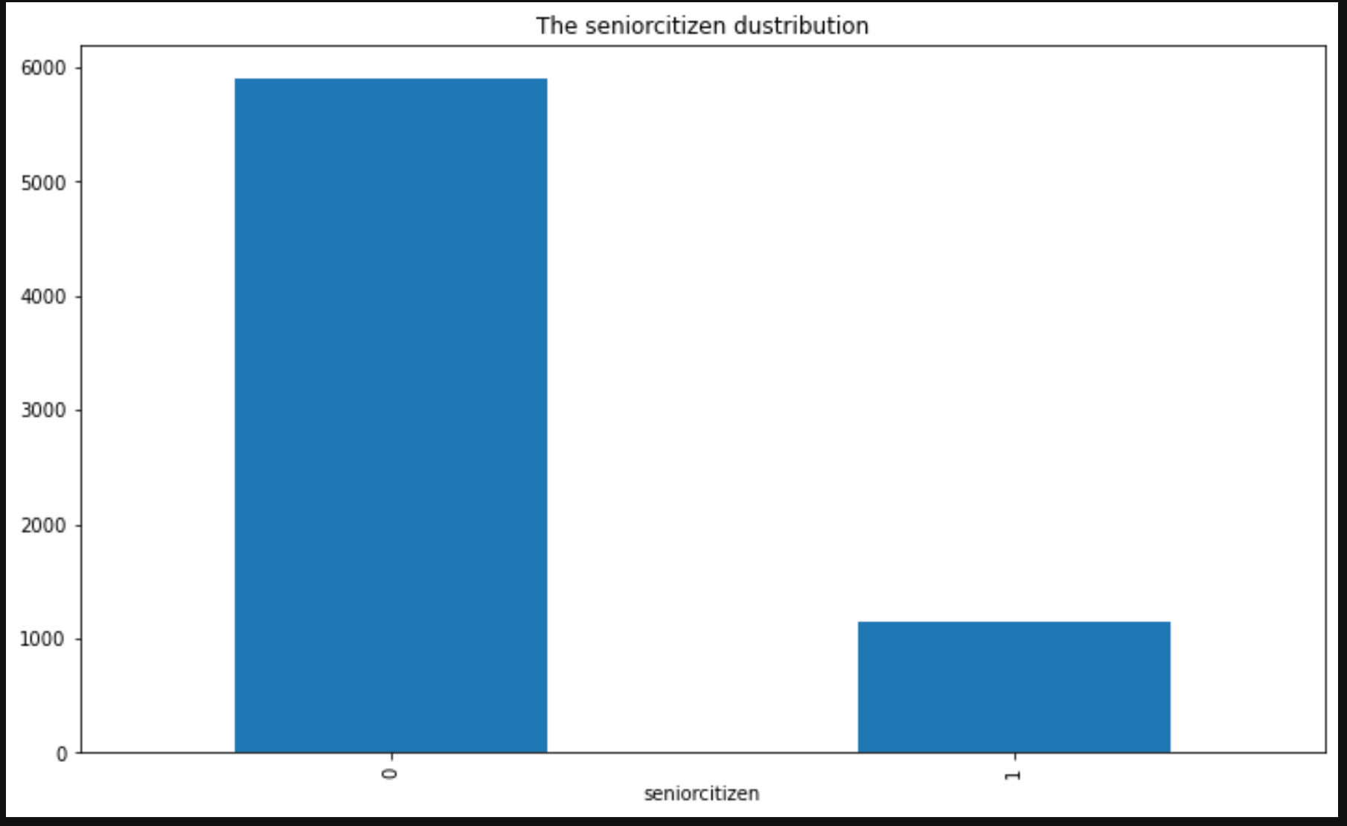
Data Description
Distribution of the labels
Gender Distribution Among Customers
Female: 3488
Male: 3555
Senior Citizens Distribution Among Customers
No: 5901
Yes: 1142

Slide 5
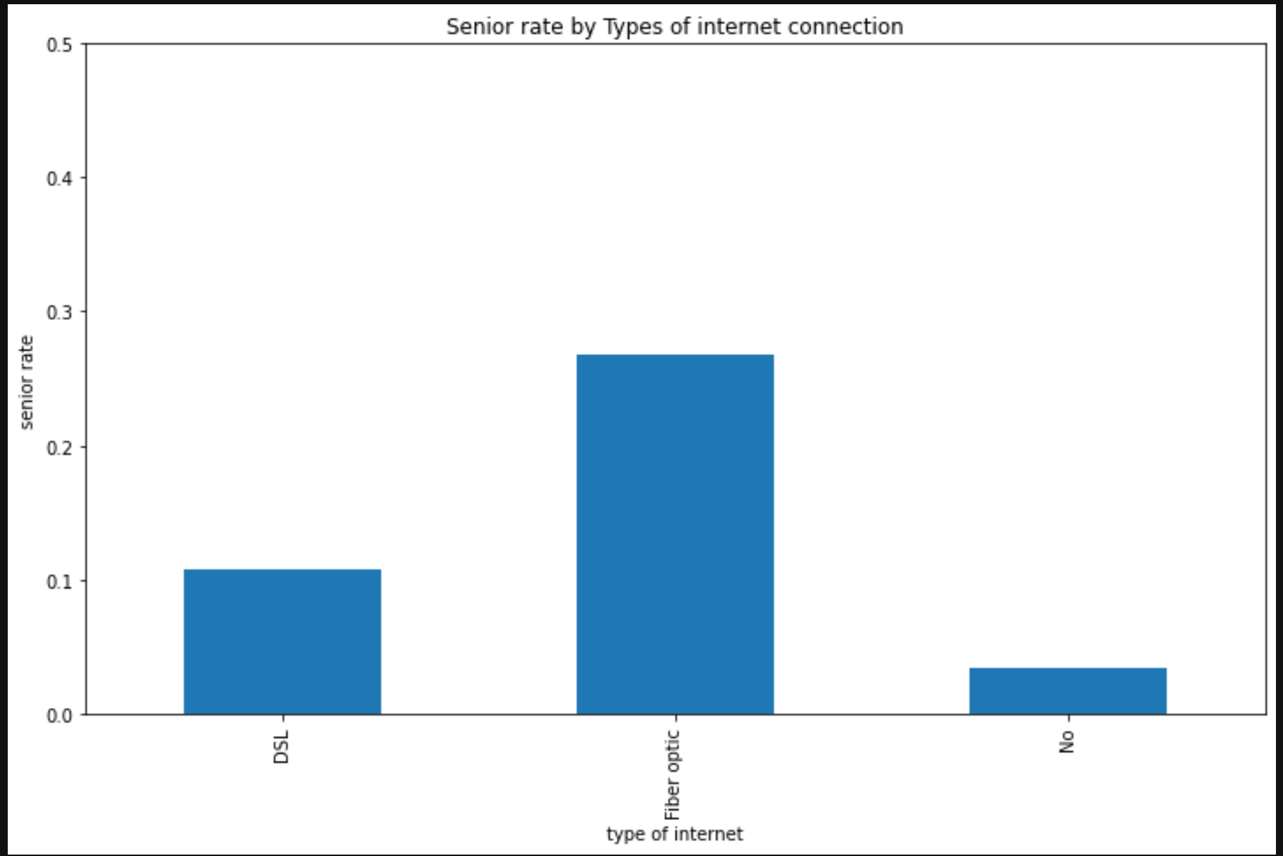
Data Description
Senior rate by Types of Internet connection
Conclusion: Most senior citizens are subscribed to the internet.

Slide 6
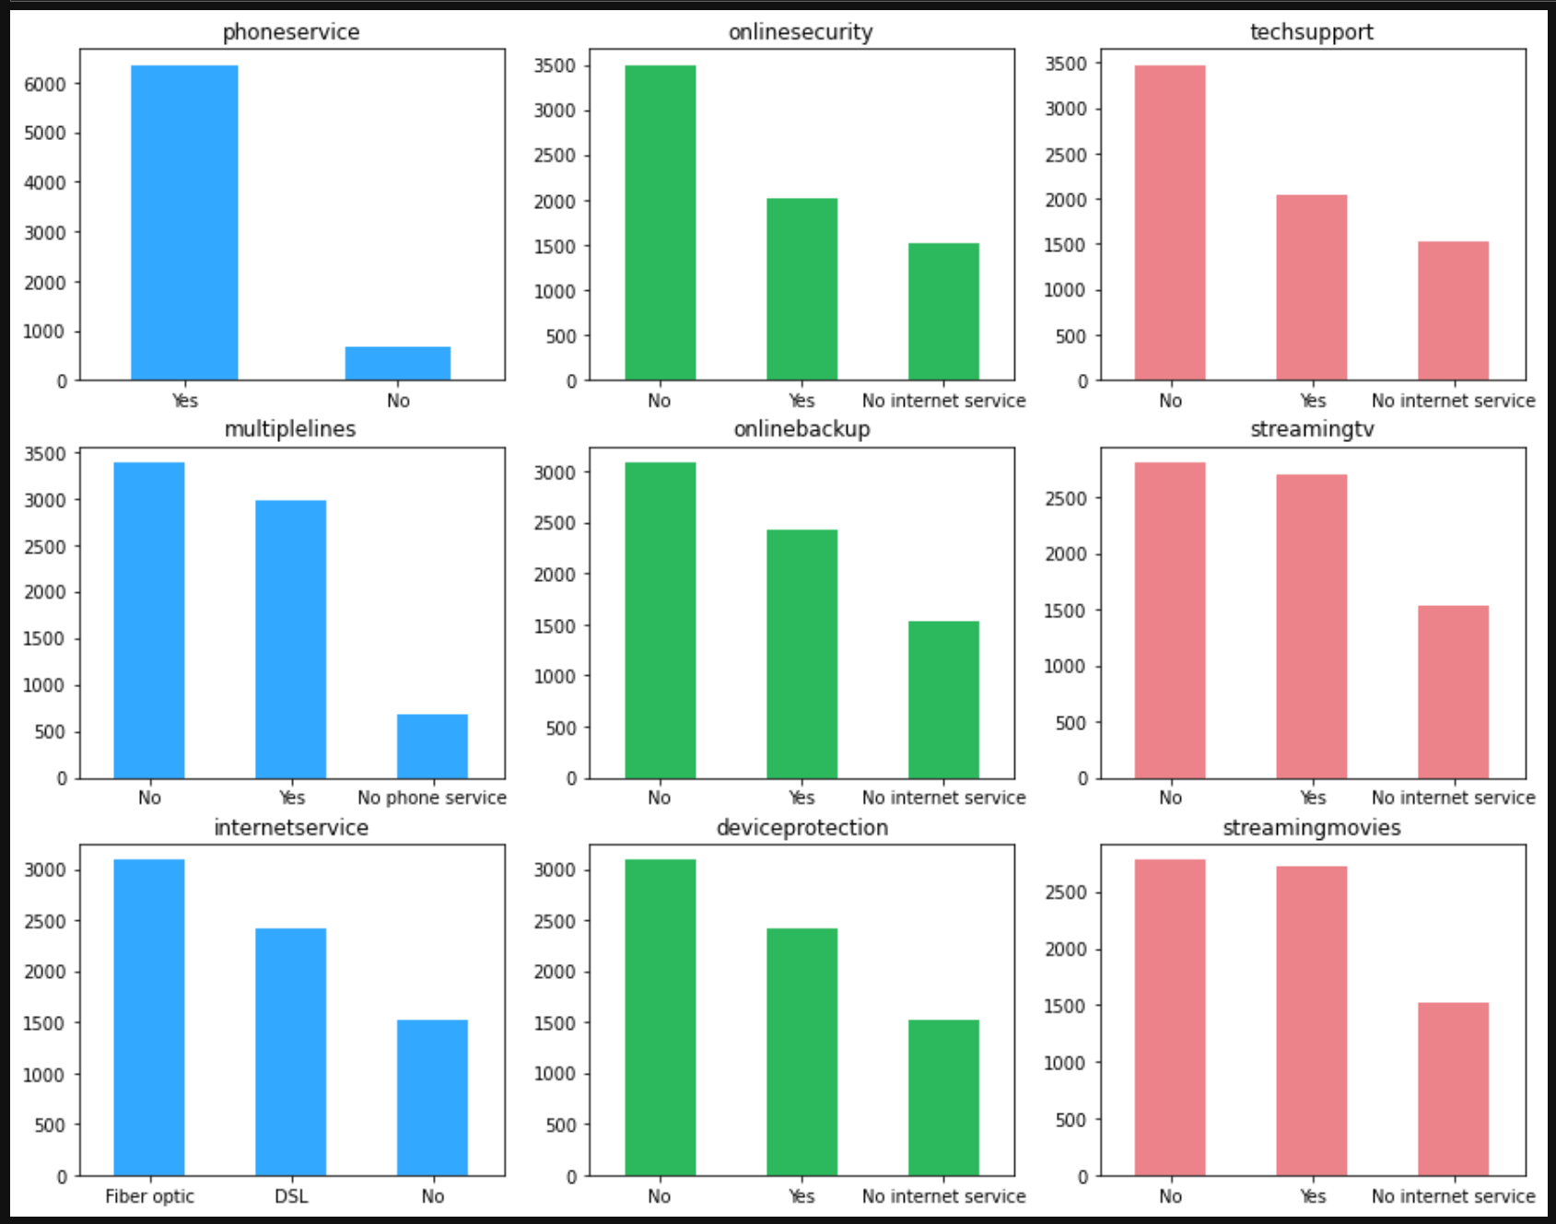
Data Description
Service Usage
Conclusions: Most customers have Phone service. Most customers have internet connection through FC and DSL technologies. Half of internet customers have a streaming TV service. Customers of Online Backup, Device Protection, Technical Support and Online Security services are a minority.

Slide 7
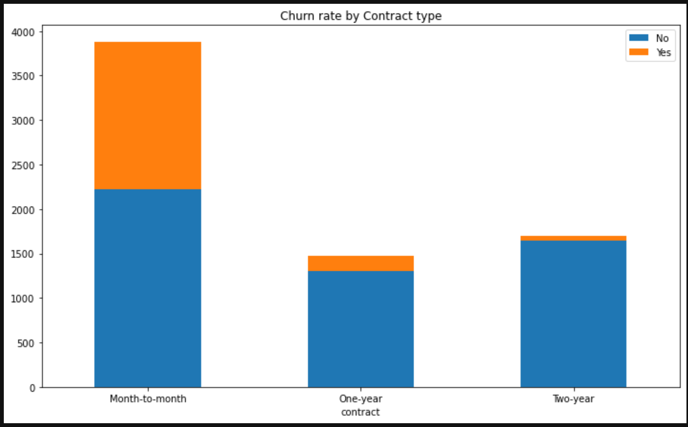
Data Description
Churn rate by Contract Type
Conclusion: Customers with 'Month-to-month' contract type have a very high probability (over 40%) to churn.

Slide 8
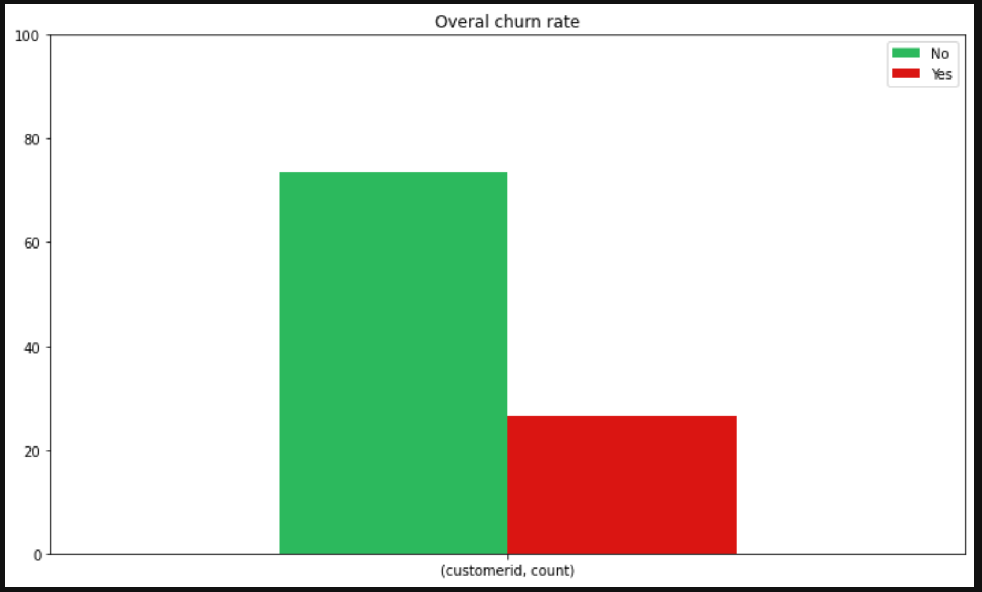
Data Description
Overall churn rate
Conclusion: 73% of the customers are active and 27% have churned the company.

Slide 9
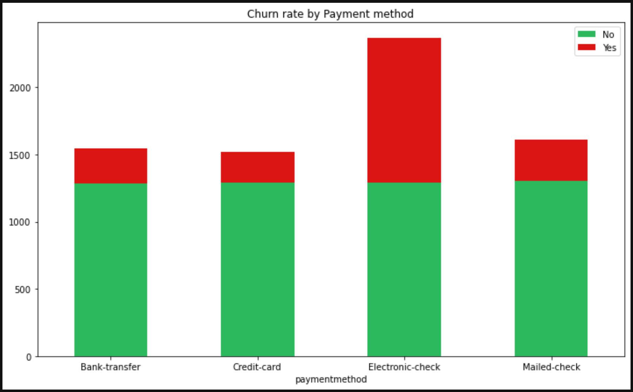
Data Description
Churn rate by Payment method
Conclusion: Customers who pay by credit card have the lowest churn rate.

Slide 10
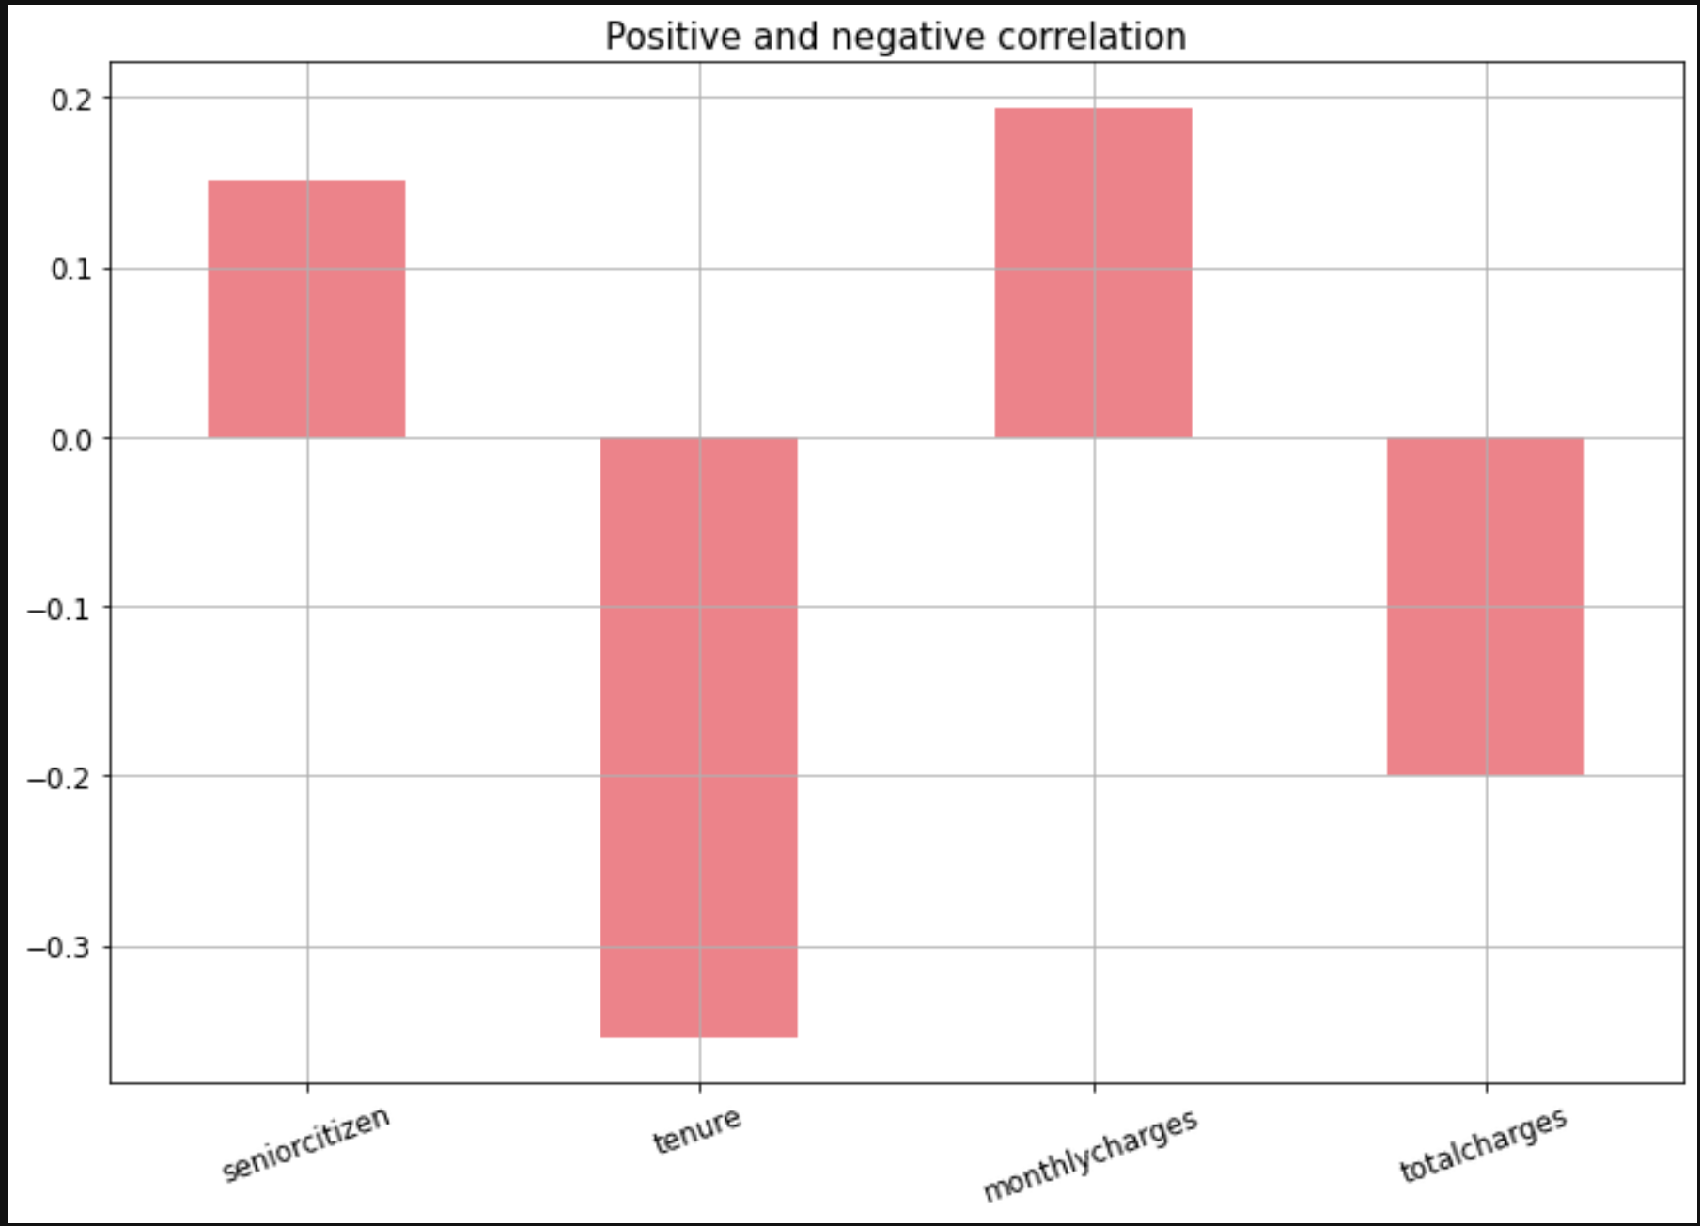
Data Description
Positive and negative correlation
Conclusion: Churn rate increases with monthly charges and age (senior citizen) and decreases with tenure and total charges.

Slide 11
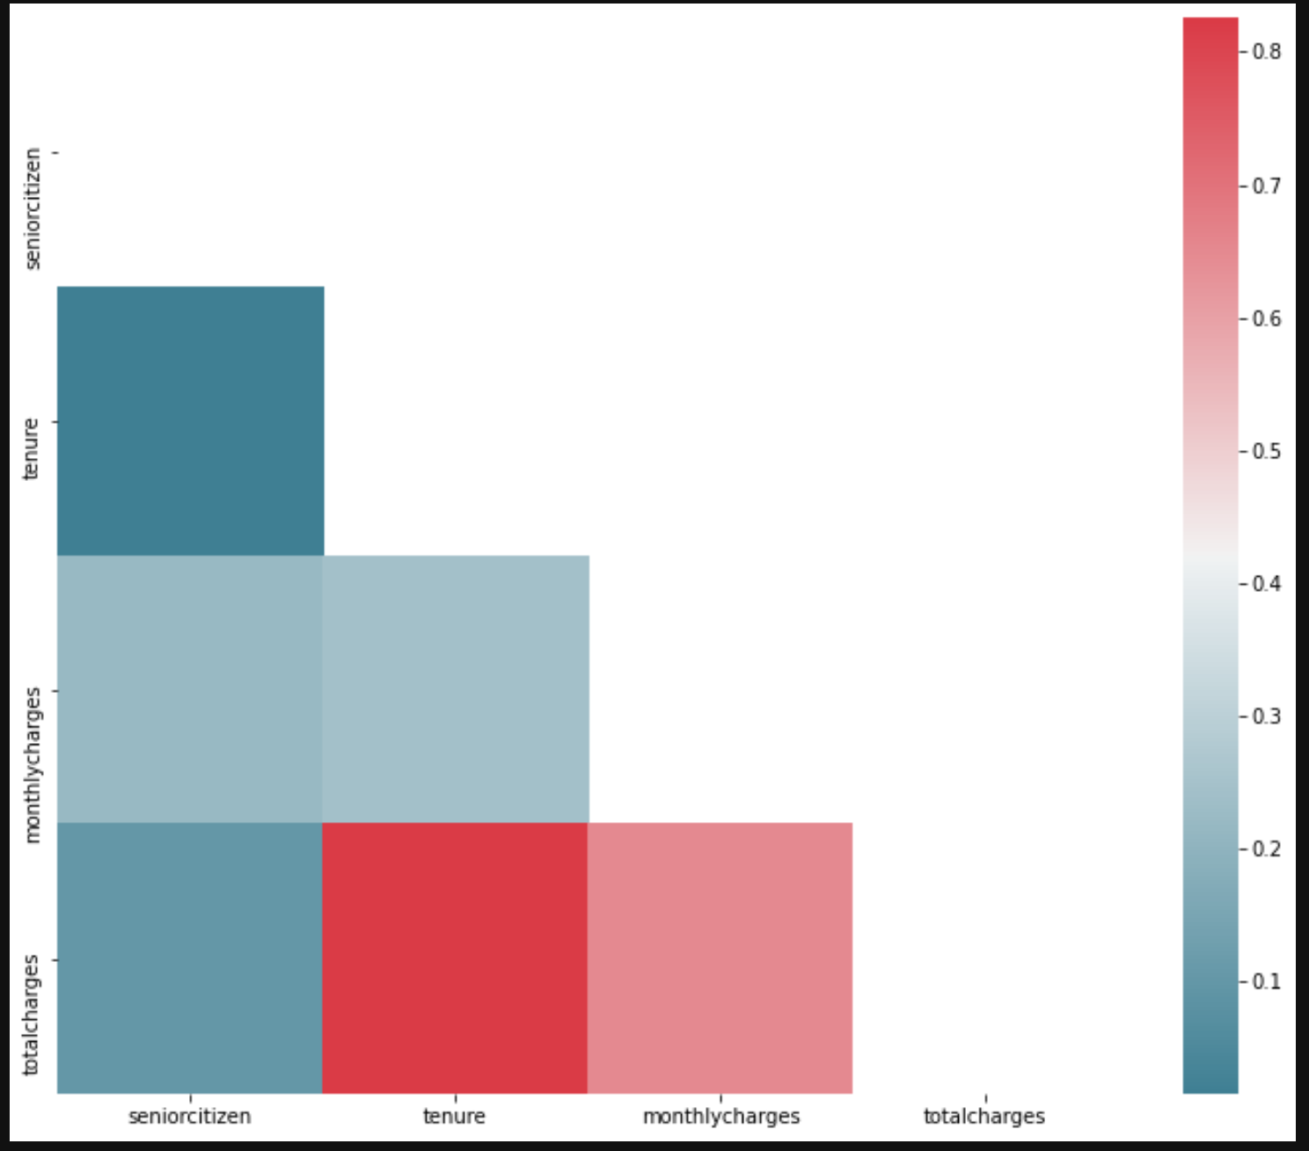
Data Description
Heatmap

Slide 12
Data Engineering

Slide 13
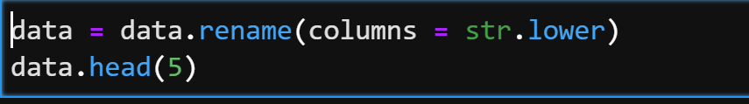
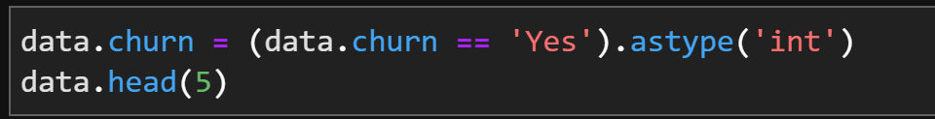
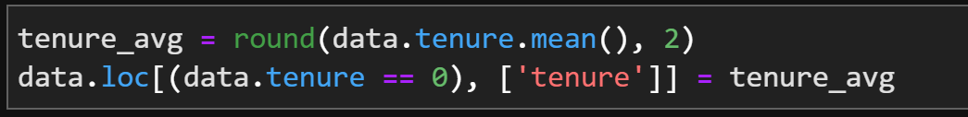
Data Engineering
Set lower case to column's names.
Convert churn column to integer data type.
Fill missing tenure data to average tenure values.

Slide 14
Prediction

Slide 15
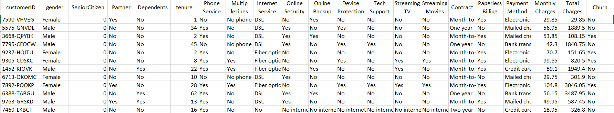
Prediction
We are trying to predict what features are the most affective in preventing costumers' churn.
The data available presents customers’ features as follows (7,043 rows, 21 columns):
We believe the way to solve the issue is to draw conclusions from the likeliness of the customers’ who churn features, in order to make improvements to allow problematic customers to remain in their communication company.

Slide 16
Prediction
There is a need to make some adjustment to the dataset in order to make it appropriate for operating on the ML Algorithms:
At first, we deleted the column of the user ID and created a new one as a numeric form. Thus we were able to convert all the dataset to float data type.
Secondly, we ran the code “get_dummies”.
After that, we used the Scikit-Learn to train 5,634 (80%) customers data rows and test 1,409 (20%).
Using three different ML Algorithms we came to the following results:
KNN - K Nearest Neighbors – the output is produced in a CVS file after running all the kernel.

Slide 17
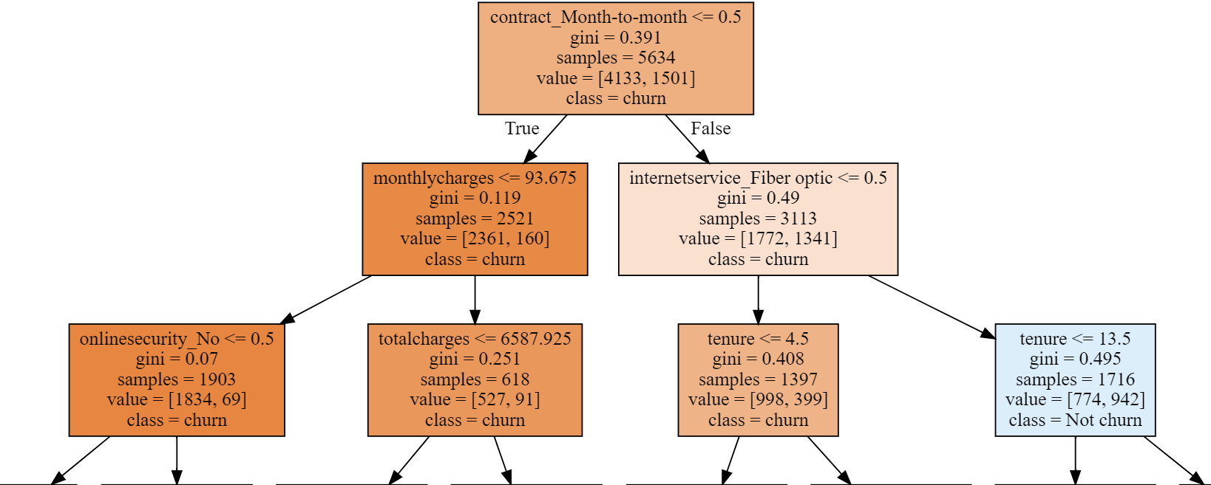
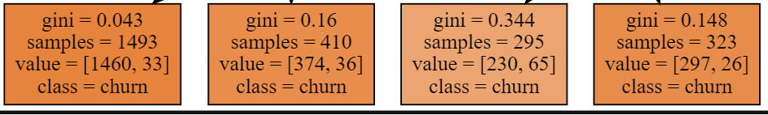
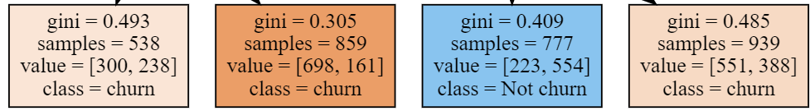
Prediction
Decision Tree

Slide 18
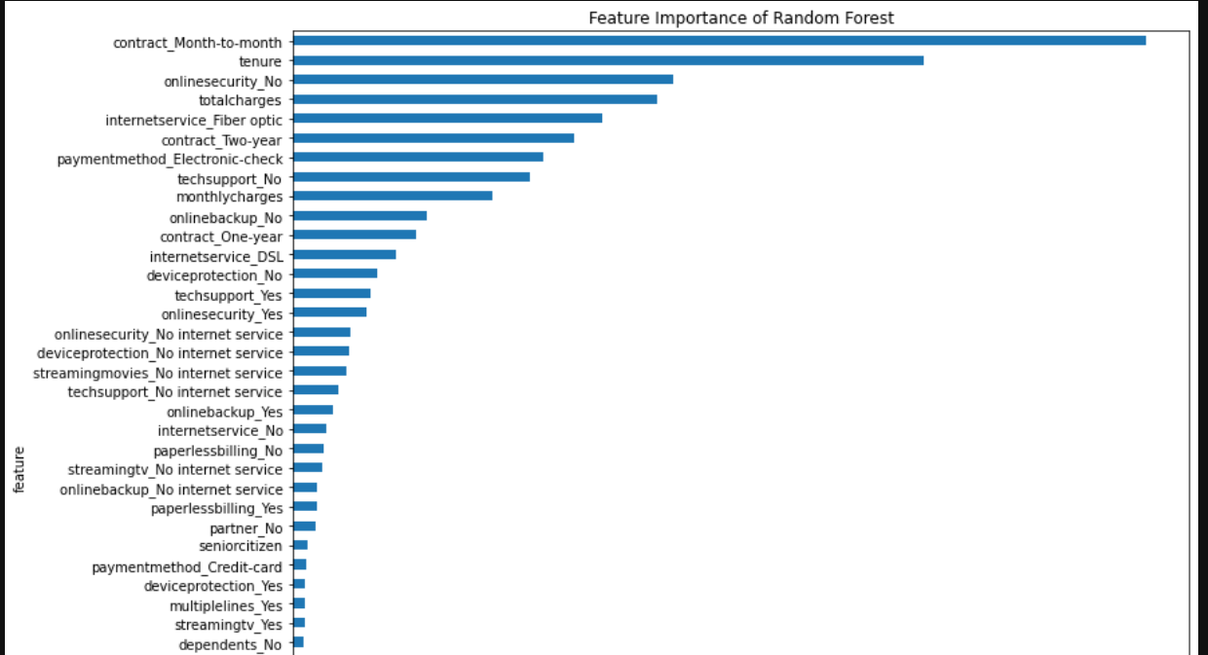
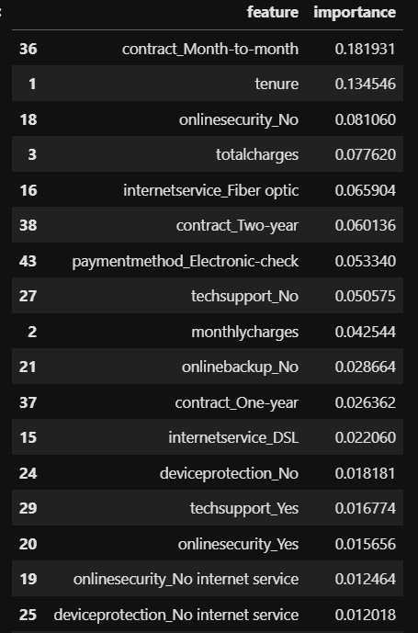
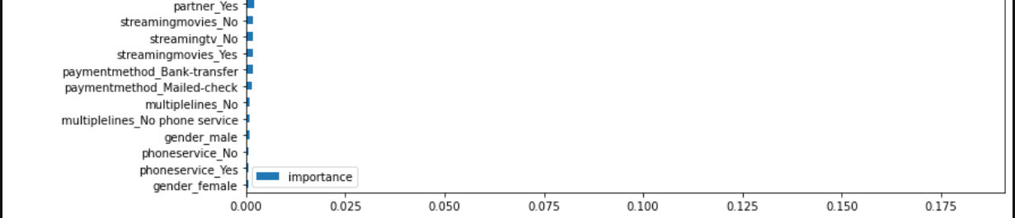
Prediction - Random Forest model

Slide 19
Prediction
Accuracy
Decision Tree ~ 78%
Random Forest ~ 79%
KNN ~ 78%
Overfitting
Decision Tree
Random Forest
Max Depth
2 | ~ 76%
3 | ~ 78%
5 | ~ 78%
100 | ~ 73%
Max Depth | n_ estimators
3 | 90 | ~ 77%
3 | 100 | ~ 77%
5 | 150 | ~ 79%
Conclusion: max_depth = 3 is the best value.
Conclusion: n_estimators = 150 & max_depth = 5 - are best values

Slide 20
Prediction
KNN
n_neighbors
3 | ~ 74%
10 | ~ 77%
20 | ~ 78%
40 | ~ 77%
Conclusion: n_neighbors=20 - the best value.
Benchmark
The prediction Benchmark is ~ 74%. It represents the top 1,409 test values (20% out of 100%). Therefore, the performance of "Random Forest" algorithm is ~ 79%, better then the benchmark.

Slide 21
Thank You

